Slide 1
Psychological influences upon breastfeeding
Dr Amy Brown

Slide 2
Overview
Attitudes
Confidence, self efficacy and assurance
Body image
Transition to motherhood
Parenting culture
Mental health

Slide 5
Common attitudes
Lots of women can’t breastfeed
Breast is best but formula is fine
Mothers shouldn’t breastfeed in public
Formula fed babies are easier
It’s about who feeds, not the milk

Slide 7
Confidence
Anxiety associated with shorter duration
Concerns over milk take & weight gain
Trying to manipulate feeding patterns
Physiological effect
Strongly linked to knowledge
Brown A, Raynor P, Lee M. Maternal control of child‐feeding during breast and formula feeding in the first 6 months post‐partum. Journal of Human Nutrition and Dietetics. 2011 Apr 1;24(2):177-86.

Slide 8
How do I know he is getting enough
Maybe I should try a top up
What if I’m starving him?
What if I’m just doing it all wrong?
Is he really meant to be feeding again?

Slide 9
Have you tied just not feeding her?
She can’t be getting enough if she’s feeding again!
It’s because you insist on breastfeeding her STILL
ROD FOR YOUR OWN BACK!
Your milk must be skimmed!
Of course she’s going to keep waking at night if you offer it to her!
Just ignore her, she can’t be hungry at night

Slide 10
Personality?
Breastfeeding
Emotional stability
Conscientiousness
Extroversion
Brown A. Maternal trait personality and breastfeeding duration: the importance of confidence and social support. Journal of advanced nursing. 2014 Mar 1;70(3):587-98.

Slide 11
We need to convince society to value and care for our new mothers better

Slide 12
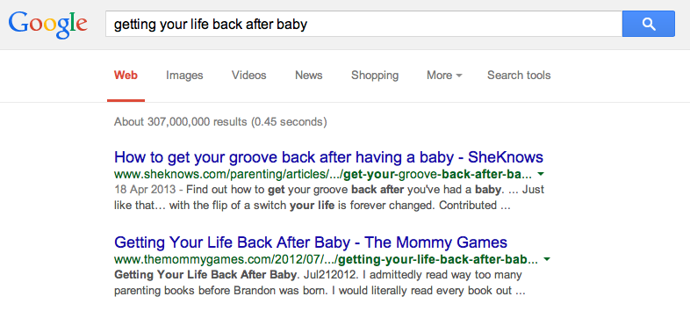

Slide 13
Body image and weight

Slide 14
Weight
Lower milk supply
Delay in milk coming in
Lower levels of prolactin (stored progesterone)
Increased risk of complications at birth
Confidence
Hilson JA, Rasmussen KM, Kjolhede CL. High prepregnant body mass index is associated with poor lactation outcomes among white, rural women independent of psychosocial and demographic correlates. Journal of human lactation. 2004 Feb;20(1):18-29.

Slide 15
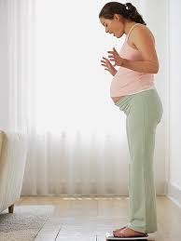
Body image
Overweight less likely to plan
Body image predicts independent of weight
Concern about current image, postnatal image and dieting
Stop for reasons related to body image
Wanting body back
Brown A, Rance J, Warren L. Body image concerns during pregnancy are associated with a shorter breast feeding duration. Midwifery. 2015 Jan 31;31(1):80-9

Slide 16
Non responsive feeding
Mothers who are obese are also more likely to feed feed to a schedule
Shloim N, Rudolf M, Feltbower R, Hetherington M. Adjusting to motherhood. The importance of BMI in predicting maternal well-being, eating behaviour and feeding practice within a cross cultural setting. Appetite. 2014 Oct 1;81:261-8.
Mothers who are obese more likely to interpret signs like crying or putting a toy in their mouth as needing more milk
Gross RS, Fierman AH, Mendelsohn AL, Chiasson MA, Rosenberg TJ, Scheinmann R, Messito MJ. Maternal perceptions of infant hunger, satiety, and pressuring feeding styles in an urban Latina WIC population. Academic pediatrics. 2010 Feb 28;10(1):29-35.
Restrained eaters more likely to feed to a routine
Brown A. Maternal restraint and external eating behaviour are associated with formula use or shorter breastfeeding duration. Appetite. 2014 May 1;76:30-5.
Mothers with a history of eating disorders feel distressed if their infant wants to feed frequently
Evans J, Grange DL. Body size and parenting in eating disorders: A comparative study of the attitudes of mothers towards their children. International Journal of Eating Disorders. 1995 Jul 1;18(1):39-48.

Slide 17
‘I think women who have breastfed understand what I'm saying - that if you get a boob job it's more reconstructive surgery, actually, than cosmetic surgery’
‘Reconstructive surgery is all about repairing people and restoring function. It is performed to repair and reshape bodily structures affected by birth defects, developmental abnormalities, trauma/injuries, infections, tumours and disease’

Slide 18
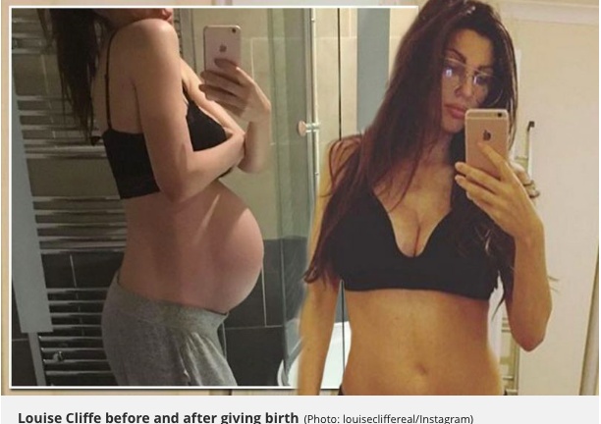

Slide 19
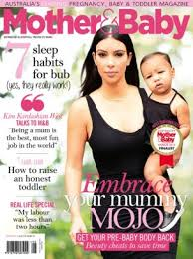

Slide 20
60% worried about losing the weight
58% feel pressured to return to pre pregnant self
68% worried about the effect of pregnancy
55% pressure to have the perfect bump
18% feel more attractive during pregnancy than usual
23% pregnancy has not affected how I feel about my body
https://theconversation.com/social-media-is-putting-pregnant-women-under-pressure-to-look-perfect-61881
Hicks S, Brown A. Higher Facebook use predicts greater body image dissatisfaction during pregnancy: The role of self-comparison. Midwifery. 2016 Sep 30;40:132-40.

Slide 22
Maternal mental health

Slide 23
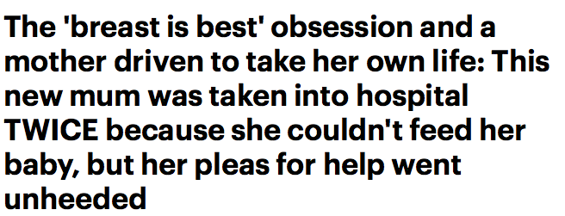

Slide 24
‘Breastfeeding stops mothers getting postnatal depression’
‘Not breastfeeding leads to postnatal depression’
‘Breastfeeding leads to postnatal depression’

Slide 25
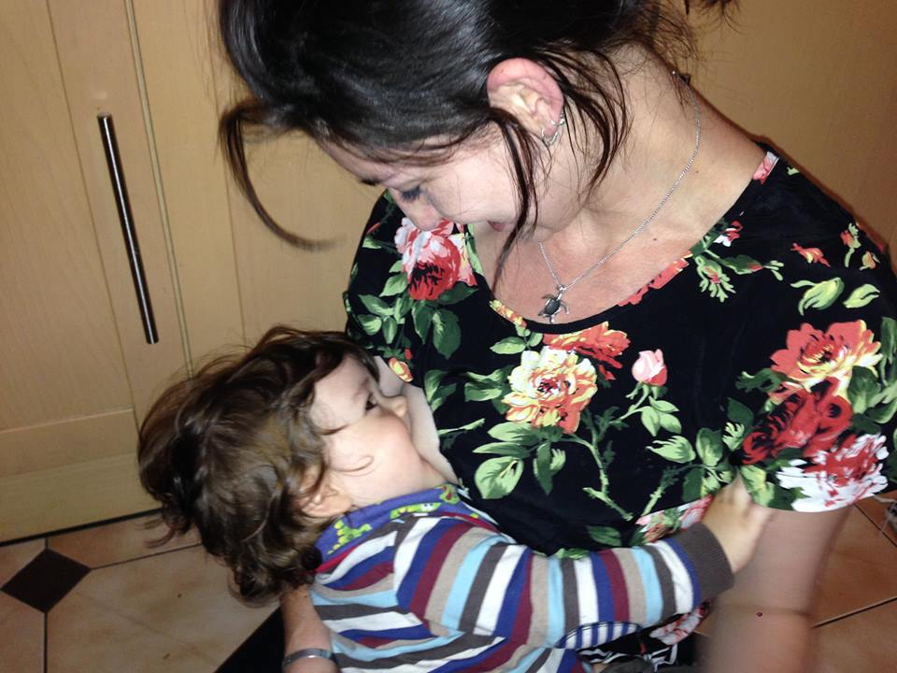
Why might BF protect against PND?
Body doing what it ‘expects’?
Expected hormonal balance
Meeting expectations
Feel doing something ‘right’?
Easier experience?

Slide 26
Why might not breastfeeding increase risk?
Dependent on context of why
Intention is important
Experience is important
Post BF feelings are vital

Slide 27
BF difficulties increase risk
Pain & difficulty associated with increased risk of stopping
Feeds are likely to be longer
More difficult than believed
Feelings of loss at stopping
Pain can lead to depression
Brown A, Rance J, Bennett P. Understanding the relationship between breastfeeding and postnatal depression: the role of pain and physical difficulties. Journal of advanced nursing. 2016 Feb 1;72(2):273-82.

Slide 28
PND makes BF feel more challenging
Mothers with PND are more likely to perceive their baby’s behaviour as more challenging .
More likely to perceive their infant as crying excessively and find it more difficult to regulate behaviour
Gonidakis F, Rabavilas AD, Varsou E, Kreatsas G, Christodoulou GN. A 6-month study of postpartum depression and related factors in Athens Greece. Comprehensive psychiatry. 2008 Jun 30;49(3):275-82.

Slide 29
PND may affect interactions
Mothers with PND have poorer interactions with their newborn such as lower touching, sensitivity and skin to skin
Mothers with depressive symptoms are less sensitive in their touch and positioning of the newborn on the breast and also reported poorer latch, lower milk intake and lower weight gain
Bigelow A, Power M, MacLellan‐Peters J, Alex M, McDonald C. Effect of mother/infant skin‐to‐skin contact on postpartum depressive symptoms and maternal physiological stress. Journal of Obstetric, Gynecologic, & Neonatal Nursing. 2012 May 1;41(3):369-82.

Slide 30
Does stress affect breastfeeding?
Possibly
Stress can inhibit oxytocin which can affect the milk ejection reflex
The first was conducted with a mother of an older baby (7 months) old and involved immersing her feet into ice water for 10 seconds every 30 seconds, giving her verbal maths problems to solve, milk electric shocks if she got the answer wrong or took too long to answer and random pulling of her big toe to cause pain. They labelled these tests ‘distractions’. On days that distractions were experienced they then injected the mother with either saline solution (a placebo) or oxytocin (to stimulate milk supply), a couple of minutes before she fed her baby. Milk intake per feed was then measured on control and distraction days. Intake on the control days was on average 168g compared to an average of only 99g on the distraction and saline day (with particularly low readings with ice water). However average milk intake on a distraction and oxytocin day was an average of 153g. The authors concluded that the distraction interfered with her milk ejection reflex.
Newton M, Newton NR. The let-down reflex in human lactation. The Journal of pediatrics. 1948 Dec 1;33(6):698-704.

Slide 31
Two further studies
Randomised breastfeeding women a week after birth to one of three groups: control, mental stress (more maths problems) and noise stress (building construction noise). They then collected blood samples before and after a feed as well as weighing infants before and after as a rough guide to intake. There wasn’t any difference in how much milk the babies received in each group, but oxytocin was 43% less in the mental stress group and 52% stress group compared to the controls
Ueda T, Yokoyama Y, Irahara M, Aono T. Influence of psychological stress on suckling-induced pulsatile oxytocin release. Obstetrics & Gynecology. 1994 Aug 1;84(2):259-62.
Mothers with a premature baby were split shortly after birth into a control and relaxation group. Those in the relaxation group listened to a relaxation tape daily, just before they expressed milk. The amount of milk mothers in this group could express after just one week was almost double those in the non relaxation group.
Feher SD, Berger LR, Johnson JD, Wilde JB. Increasing breast milk production for premature infants with a relaxation/imagery audiotape. Pediatrics. 1989 Jan 1;83(1):57-60.

Slide 32
Might other factors play a role?
Birth complications
Physiological impact
Psychological impact
Residual pain affects sleep
Personality link?

Slide 33
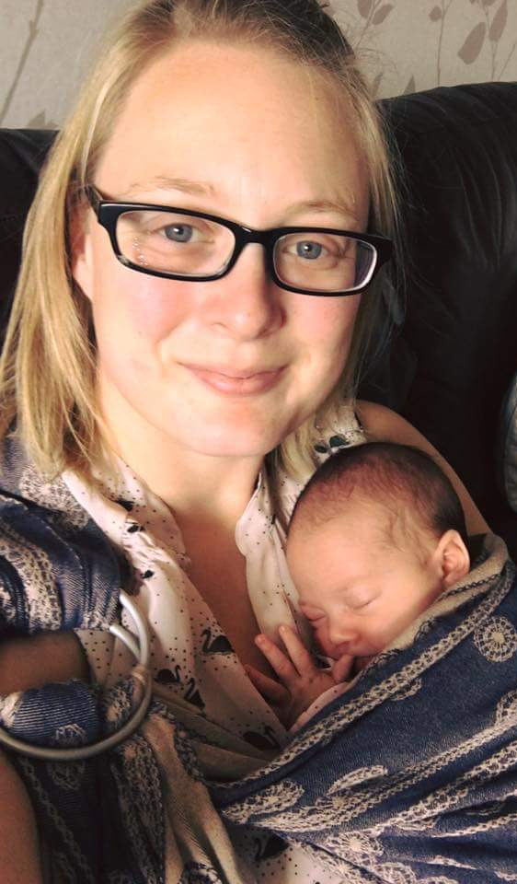
Transition to motherhood

Slide 34
Mothering
Rachel Cusk in her book ‘A life’s work’, gives the following quote from a mother
‘The Doctor said ‘I think you are a bit depressed.’ I am exhausted, I have no job, I have no life, I am stuck at home with this crying baby and these pointless domestic tasks to do … You go nuts just walking around with these books, thinking can he have butternut squash … wouldn’t you be depressed?’

Slide 35
Kitzinger (1992) Ourselves as mothers
‘Mothers are instructed that they must keep the romance in her relationship good, cook gourmet food and produce candlelit dinners and at the same time be a perfect mother’
‘ A woman who catches sight of herself in the mirror sees a very different picture. And the message is clear: she is a failure’.

Slide 36
Are we really prepared to become mothers?
‘I’m not sure what I thought would happen. I guess I hadn’t really thought about life much with the baby. The birth, yes. But the baby? I thought we’d take him home, bursting with pride in what we had made and I would sit on the sofa and watch him peacefully sleep. I had great plans of coffee with friends, trips to the hairdresser after not getting it coloured during pregnancy and lots of walks in the park laughing and playing with my beautiful son. I’d even planned my new mum wardrobe like the magazines showed. And breastfeeding would be beautiful right? Then reality hit. I had stitches that stopped me walking for a while. Then it rained. A lot. He cried, a lot. I cried a lot. He had colic. I sometimes didn’t get changed out of my pyjamas. My hair lived tied back on top of my head. I didn’t drink a cup of coffee whilst it was still hot for a long time. My friends all had jobs and lives. And most of all I felt very alone, both physically and in terms of how I felt. I didn’t think anyone else could feel this way.’

Slide 37
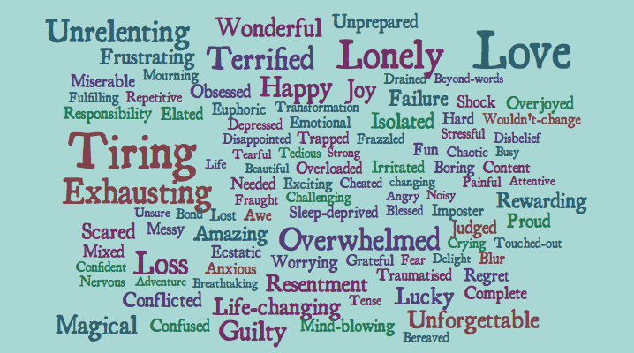
The Creative Motherhood Project
We asked over 1000 women how they felt about becoming a mother …
Dr Amy Brown, Dr Kate North & Dr Rebecca Clifford
www.creativemotherhoodproject.com

Slide 39
(Damaging) concepts of the ‘good mother’
Enjoys every moment
Is blessed
Precious moments & memories
Grateful
Has a ‘good’ baby

Slide 40
How does this fit with breastfeeding?
Caring for a new baby is exhausting
Feeding responsively is exhausting
But why is the solution always formula?
And non responsive feeding styles?
Why isn’t it for them to do the housework?

Slide 41
You need to start caring for yourself
Give him to me, I’ll give him a bottle and you can go out
You could get on with other things if I fed him
It can’t be good for him feeding this much
Let me give him a bottle
If you swap to formula I’ll do half the feeds
Let me have him overnight

Slide 42
‘I was absolutely exhausted and overwhelmed with it all and a few people suggested I give up breastfeeding to get a break. I felt like a useless mother in so many other ways but the breastfeeding was the part I really loved and felt like I was doing a good job at. It helped me stop, escape and just be whilst I was feeding. It was all the other things I wanted to escape from and stopping breastfeeding wouldn’t solve that’

Slide 43
Does formula feeding reduce the load?
Breastfeeding mums actually spend less time preparing / feeding / settling their babies
Smith JP, Forrester R. Who pays for the health benefits of exclusive breastfeeding? An analysis of maternal time costs. Journal of Human Lactation. 2013 Nov;29(4):547-55.
Breastfeeding mums get more sleep
Doan T, Gay CL, Kennedy HP, Newman J, Lee KA. Nighttime breastfeeding behavior is associated with more nocturnal sleep among first-time mothers at one month postpartum. Journal of clinical sleep medicine: JCSM: official publication of the American Academy of Sleep Medicine. 2014 Mar;10(3):313-9.

Slide 44
So how do we as a society help our new mothers?

Slide 45
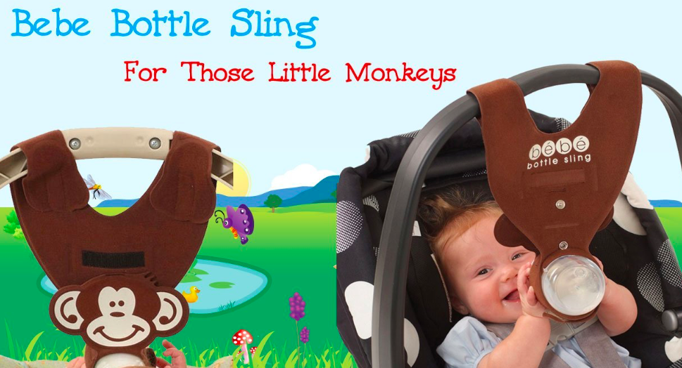
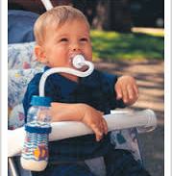

Slide 46
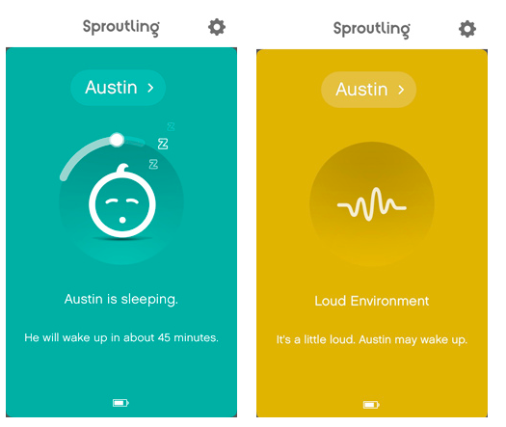
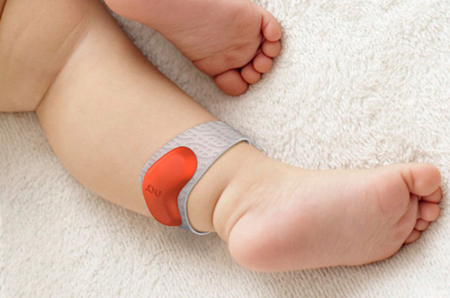

Slide 47
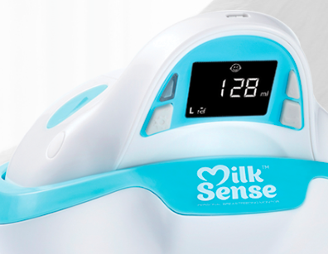

Slide 48
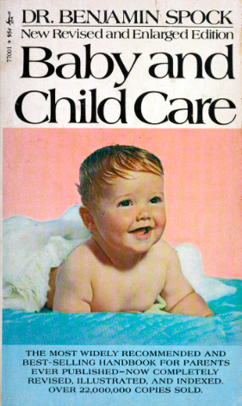
‘‘They come to realise that they don’t need the late night feeding and most of them give it up at 1, 2 or 3 months of age.
If babies reach the age of 1 month and weigh 9 pounds and still wake for a 2 am feeding, I think it’s sensible for the parents to try to influence them to give it up’
‘Be conscious that some babies think your sole purpose in life is to help him fall asleep’
‘During night feeds try not to talk to your baby

Slide 49
Tizzy Hall
‘One aspect I considered is whether the quality of the mother’s milk changes when she puts her baby on a routine. Because cows milk is close to human milk, which is why we drink it and feed it to our children – I decided to discuss it with various dairy farmers.
Dairy farmers stick to strict routines in relation to their milking. Most will milk their cows at 5 am and 3pm every day. When I enquired why it was explained to me that milking the cows at a set time every day meant their metabolism knew exactly when and how much milk to produce.

Slide 50
The farmers said that if they milked their cows earlier or later than scheduled, the milk would not be of the highest quality or quantity. It’s not such a leap to come to the conclusion that this might be the same for a breastfeeding mother’s milk supply’

Slide 51
We need to convince society to value and care for our new mothers better

