Slide 1
Generations in the Workplace
February 8, 2017
Presenting To
Arizona WIC Partner Meeting | ADHS
Therese Valadez | ADOA CHRO ADHS

Slide 2



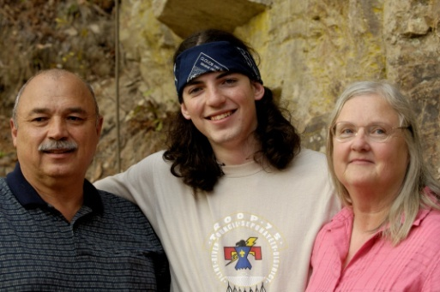



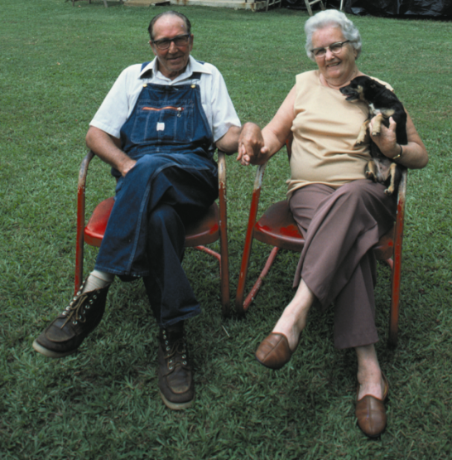
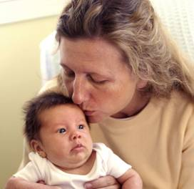

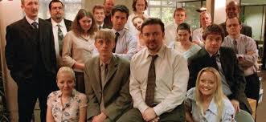

GENERATIONS IN THE WORKPLACE
Notes:
The modern workplace is no different than those of years past, with Generation Y, Generation X and baby boomers all coexisting in the same office. But as more boomers work past retirement age, and tech-savvy millennials continue to graduate and enter the workforce, the stark differences in the values, communication styles and work habits of each generation are becoming increasingly pronounced. With post-millennials— known to some as Generation Z — quickly approaching college age, the next generation will be joining the ranks of working professionals within the next few years — meaning that a four-generation office will soon become the new norm. Leaders must be ready to take on the challenge of integrating newer workers while still respecting the seniority and experience of older ones.

Slide 3
What is a Generation?
“In addition to coincidence of birth year grouping, a generation is also defined by common tastes, attitudes, and experience….
Those times encompass a myriad of circumstances – economic, social, sociological, and, of course, demographic.”
Zemke, R. Raines, C., & Filipczak, B. (2010) Generations at work: Managing the clash of Veterans, Boomers, Xers, and Nexters in your workplace. New York:Amacon.
Notes:
Not everyone fits their generational profile perfectly – it is about common experience.
The focus is on the feel and face of a generational cohort.
An old adage holds that “people resemble their times more than they resemble their parents.”
Generations overlap at their endpoints, so there are no hard signs when one generation stops. In addition, those born closer to the start of one generation may have a slightly different experience then those born at the end of the same generation. For example, some say Boomers end at 1960 and others indicate 1964 is the end of the boomer generation
Much of this research is based on mainstream American ideas and perspectives.
We understand that stereotyping is dangerous (whether by generation or any other characteristic). The idea is to help us explore the problems, pressures, and opportunities of working, learning, and living in a world of mixed generations.
Unique individuals are a result of their own makeup and unique experiences in addition to these generational experiences. Remember that there is as much within generation difference as difference between generations.

Slide 4
Generations
Traditionalists/Silent Generation/Matures
1925 – 1945 (89 – 69 years of age)
Baby Boomers
1946 – 1964 (68 – 50 years of age)
Generation X/Baby Busters/13th Generation
1965 – 1981 (49 – 33 years of age)
Millennials/Generation Y
1982 – 2000 (32 – 14 years of age)
Nexters/ Generation Z
2001 – present (13 – 0 years of age)
Notes:
People from different generations are working at the same place at the same time – all trying to contribute to the same mission.
Four generations exist in the workplace in significant numbers, but not just in the workplace, think of our volunteers, parents, and even suppliers. Different values, experiences, styles, and activities sometimes create misunderstandings and frustrations.
Everyone has different perspectives on the meaning of “employment,” how work should be done, and what workplaces should be like – all of which add to the potential for conflict.
(As you go over each generation, ask who in the class is from that generation)
[give out awards – traditionalists = handshake and a note of thanks; Boomers = certificate showing completion; Xers = a pass to decide when group should have a break; Millennials = ribbon ]
Talk about cuspers – individuals from near the beginning or end of a generation that can have values, and beliefs of both generations.
GenX correct Boomers > fill role of GI generation (WWI)
Millennials will correct GenX > fill role of Traditionalists (WWI)
*Each new youth generation breaks with the styles and attitudes of the young-adult generation (today, Generation X), which no longer function well in the new era. They correct for what they perceive as the excesses of the current midlife generation (today, Boomers), which includes their parents and the nation’s political leaders. And they fill the social role of being vacated by the departing elder generation (today, G.I.s), a role that now feels fresh, functional, desirable, and even necessary for society’s wellbeing. Millennials in the Workplace by Neil Howe

Slide 5
Generations Exercise
EACH GENERATION CONTRIBUTES
POSITIVE TRAITS &
CHALLENGES
TRADITIONALISTS
BABY BOOMERS
GEN Xers
MILLENNIALS
GENERATION Z
Notes:
Flip chart for each generation – with POSITIVE TRAITS and CHALLENGES columns. Have group call out 2-3 of each.
-OR-
Around the room we have sheets of paper for each generation. You will see that the paper has a place for positive traits and one for challenging traits. Think about the people you work with from each of these generations, as a group what makes this generation easy to get along with in the workplace, and what do you find is a challenge.
Take a few minutes and list these traits on each of the sheets around the room (if there are enough people from each have them only fill in the traits for generations other than their own.

Slide 6
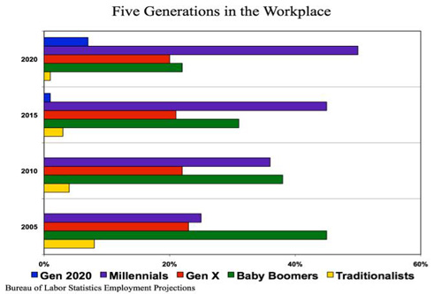
Notes:
Fact from the U.S. Bureau of Labor Statistics. From 2005 to 2020 the majority workforce will shift from the Baby Boomers to
the Millenials.

Slide 7
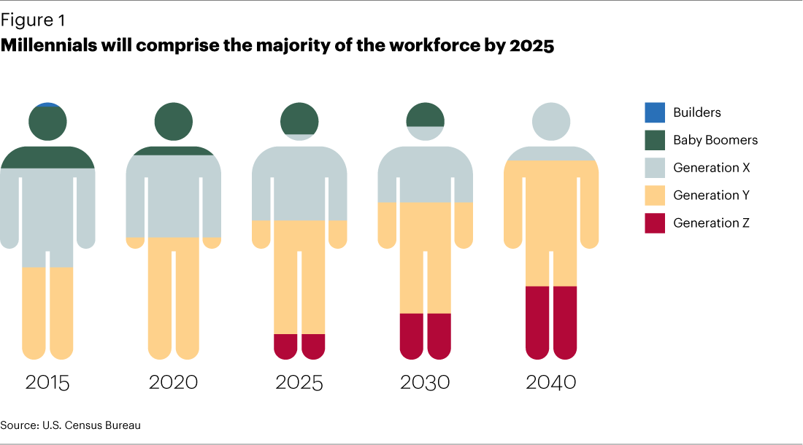
Notes:
Facts from the U.S Census Bureau

Slide 8

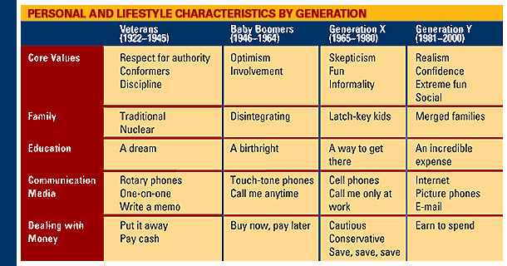

Slide 9
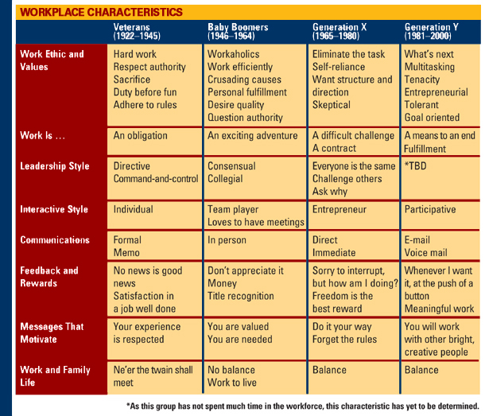

Slide 10
What makes one generation different from another?
Shared life experiences
Notes:
Each of us is a unique human being; we do not fit perfectly into any one mold or category nor will we exhibit every characteristic commonly associated with OUR generation. Generations are defined by common values and shared experiences.

Slide 11
Events and Experiences that Shaped Generations
Traditionalists
Great Depression
New Deal
Attack on Pearl Harbor
World War II
Korean War
Radio
Telephone
Baby Boomers
Civil rights
Feminism
Vietnam
Cold war
Space travel
Assassinations
Scientific advances
Credit cards
Television
Notes:
The events that we experience in our youth help shape our worldview. These are the defining events that shape a generation and bind us together in the way we work and live our lives.
For the Traditionalists, living as a youth through the great depression and the New Deal policies of FDR helped shape their attitudes about work. They learned the value of work and of stability and seek that in their life because of these early experiences. They also helped in the war efforts as a youth and remember their fathers and other family members going to and returning from World War II. Some also took part in the WWII or the Korean War.
Baby Boomers generally see the world in black and white when asked about diversity because they were youth during the civil rights movement. They were also shaped by the Feminist movement and were the first generation where females moved into the workplace and stayed in the workplace in record numbers. Baby boomers lived during a time or protest and civil disobedience over the Vietnam War and the assassination of major political leaders. They also witness space travel in their youth and saw a man walk on the moon. Space travel represents adventure and limitless possibilities. Science advances including vaccines eliminated diseases. Credit cards were introduced and increased this generations spending. Televisions became common in households and kids and adults watched programs like Romper Room, I love Lucy, The Jack Benny Show; Dragnet; Gun smoke, The Rifleman.

Slide 12
Events and Experiences that Shaped Generations
Generation X
Fall of the Berlin Wall
Challenger disaster
Desert Storm
Personal computers
Working mothers
MTV
Divorce
Energy crisis
Millennials
Child-focused world
School shootings
9/11
Boston Marathon
Internet
Social networking
Continual feedback
Enron/WorldCom
Iraq/Afghanistan
Notes:
Generation X has lived in a time of general peacefulness with the only war being Desert Storm which lasted only a few months and was over. They saw the end of the Cold War with the fall of the Berlin Wall. Their idea of space travel is of the danger as their memory is of the Challenger disaster. They also came of age during the energy crisis and a time of layoffs in industries. They are also the PC generation. They have basically had computers in their schools and homes through most of their childhood. They are very computer literate.
Millennials have grown up during a time of general prosperity and have been raised and coddled in a child focused world where everyone is a winner. Some tragic events have also shaped their worldviews such as Columbine and the 911 attacks. They are growing up in a world where terrorism is the clear and present danger. They are also growing up in the age of the internet where information is freely exchanged and any question can be answered in a matter of minutes or seconds (depending on your connection time). They get continual feedback, can look at their grades online and their class rank, can Twitter each other to keep up on their social life or use Facebook or MySpace to connect.
Ask class what other experiences define their generation.

Slide 13

Traditionalists
Born 1925 to 1945
49 million people
Grew up with many rules and pressure to conform
Increased prosperity over their lifetime; however, they remember the Depression
“Work First!”
Children should be seen and not heard
Expected lifetime career with one employer
Prefer communication in writing
Desire to leave a lasting legacy
Notes:
So how did these events shape the characteristics of each generation?
Characteristics – Patriotic; loyal; “Waste not – want not”; faith in institutions; one company career; military influenced; top down approach
Key descriptor – loyal
Slogan – “Keepers of the Grail”

Slide 14
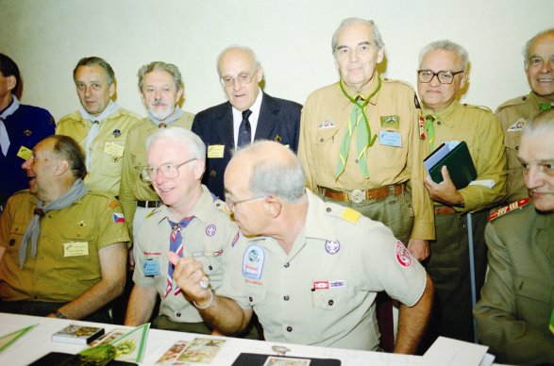
Common Values
Traditionalists
Hard work
Dedication and sacrifice
Respect for rules
Duty before pleasure
Honor
Conformity
Loyalty
Frugality
Notes:
The Silent Generation values conformity, no one should stand out everyone should work for the common good. Dedication and sacrifice means that you work to the common good. Age = seniority.

Slide 15

Baby Boomers
Born 1946 to 1964
79 million
Grew up with fewer rules and a more nurturing environment
Lived in generally prosperous times, but experienced layoffs
Women entered workforce in record numbers
“Live to Work!”
Spend “quality time” with children
Excelling in their career is important
Prefer telephone or face-to-face communication
Desire challenge and opportunity
Notes:
Major influences – Suburbia, TV, Vietnam, Watergate, Protests, Human Rights and Women’s Movements, drugs, sex, and rock n roll
Characteristics – idealistic, competitive, question authority
Key descriptor – optimist
Slogan: “Thank God It’s Monday”
Dr Spock’s Baby and Child Care – one of the biggest best sellers of all time.

Slide 16
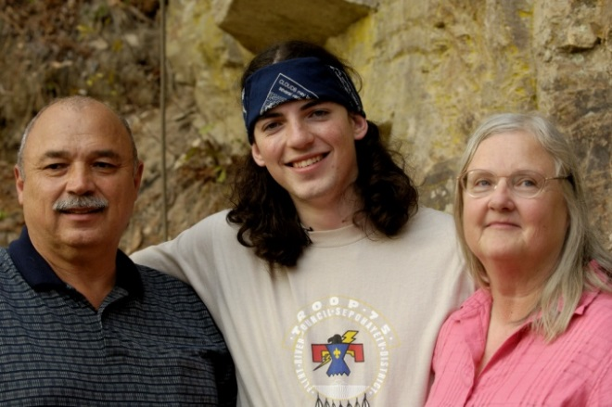
Common Values
Baby Boomers
Optimism
Team orientation
Personal gratification
Involvement
Personal growth
Workaholics
Competitors
Notes:
Baby Boomers rebelled against the conformity of the traditionalists - although they did take on the value of team orientation. But as a rebel they put personal gratification above group sacrifice of the generation before. Boomers tend to believe that success is only achieved through hard work (long hours) and playing nice, but being competitive.

Slide 17

Generation X
Born 1965 to 1981
49 million
Grew up as latchkey or day care children
Turbulent economic times – downturn in 80s, upswing in 90s
“Work to Live!”
Friends with their child, want to spend quantity time
Expect their career to keep moving forward or they will leave
Prefer electronic communications
Change from job security to career security
Notes:
Born between 1965 and 1981; this group holds strong positions in key mid-manager, supervisor, and team leaders. Many are rapidly approaching the mid point of their working careers.
Does anyone know why they are also referred to as the 13th generation? (the 13th generation from the pilgrims landing at Plymouth Rock)
Other 13th generation notes - Generation X is "the 13th generation" to be familiar with the flag of the United States (counting back to the peers of Benjamin Franklin).^{[3]} The label was also chosen because, according to generational theory, it is considered a "Reactive" or "Nomad" generation, composed of those who were children during a spiritual awakening. Older generations generally have negative perceptions of Reactive generations—whose members tend to be pragmatic and perceptive, savvy but amoral, more focused on money than on art^{[19]}—and the use of 13 is also intended to associate this perception with the negative connotations of that number.
The authors highlight this negative perception by noting the popularity of "devil-child" movies, wherein children are portrayed as malevolent protagonists (e.g. Rosemary's Baby^{[20]}), released soon after the generation's first members were born

Slide 18

Common Values
Generation X
Diversity
Techno-literacy
Fun and informality
Self-reliance
Pragmatism – realists
Results oriented
Individualism
Challenge the system
Notes:
Generation X came of age when the U.S. was losing. There was a slight depression, their parents experienced layoffs. This generation also has no heroes. Latch-key kids they had to come home and take care of their brothers and sisters. This created a large amount of independence and self-reliance in this generation.
Major Influences – Sesame Street, MTV, Game Boy, PC, divorce-rate tripled, latch-key kids, left alone
Characteristics – eclectic, resourceful, self-reliant, distrustful of institutions, highly adaptive to change & technology
Key descriptor – Skeptic
Slogan – “Work to Live”

Slide 19
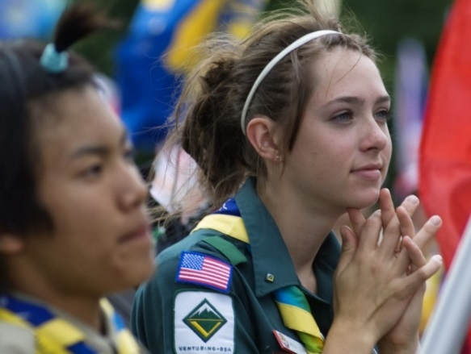
Millennials
Born 1982 to 2000
75 million
Attended day care, very involved “helicopter” parents
Prosperity has increased over their lifetime
“Live, then Work!”
Achievement oriented
Prefer instant or text messaging
Want to build parallel careers – experts in multitasking
Notes:
Major Influences – Expanded technology, natural disasters, violence, gangs, diversity, coddled by parents
Characteristics – Globally concerned, realistic, cyber-savvy, suffer “ADD”, remote control kids
Key descriptor – Realist
Slogan – “Its all about me”

Slide 20
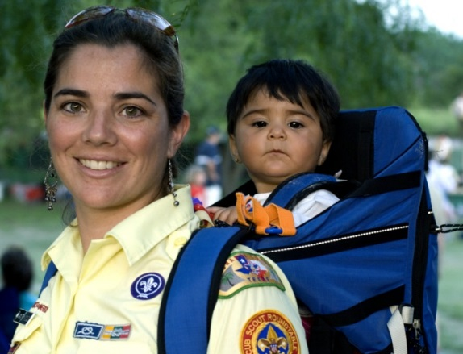
Common Values
Millennials
Optimistic
Civic duty
Confident
Achievement oriented
Respect for diversity
Informal
Tenacious
Social consciousness
Notes:
Millennials have a very short attention span because they are in a get it fast and get it now world. They are very team oriented. They feel a camaraderie with the Silent Generation.
Millennials do not value Generation X because they do not get their angst.

Slide 21
On-the-Job Strengths
 | Trads | Boomers | Xers | Millennial
Job Strength | Stable | Service Oriented/Team Players | Adaptable and Techno-Literate | Multitaskers and Techno-Savvy
Outlook | Practical | Optimistic | Skeptical | Hopeful
View of Authority | Respectful | Love/Hate | Unimpressed and Unintimidated | Polite
Leadership | By Hierarchy | By Consensus | By Competence | By Pulling Together
Relationships | Personal Sacrifice | Personal Gratification | Reluctant to Commit | Inclusive
Notes:
These next two slides / pages in your notes show strengths and challenges that each generation brings to the workplace.
Are any of these differences particular strengths or challenges for you in your work?

Slide 22
On-the-Job Strengths
 | Trads | Boomers | Xers | Millennial
Time on the job | Punched the clock | Visibility is key “Face Time” | As long as I get the job done, who cares | It’s quitting time – I have a real life to live
Diversity | Ethnically segregated | Integration began | Integrated | No majority race
Feedback | No news is good news | Once a year with documentation | Interrupts and asks how they are doing | Wants feedback at the push of a button
Work/Life Balance | Needs help shifting | Balances everyone else and themselves | Wants balance now | Need flexibility to balance activities

Slide 23
Generational Challenges We Face in the Workplace
Poor communication
Decreased productivity, quality, & innovation
Misunderstood attitudes, relationships & working environments
Less engaged volunteers & coworkers
Lack of motivation, initiative, and team work
Notes:
We can create a frustrating place to work when we fail to understand each other and how to work together.

Slide 24
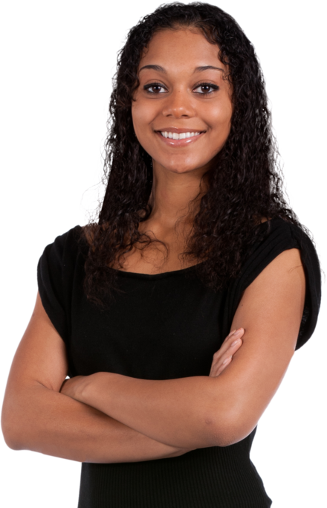
On-the-Job Challenges
Traditionalists and Boomers generally do not question or challenge authority.
Xers and Millennials have been taught to speak up.
Notes:
Traditionalists and Boomers generally do not question or challenge authority or the status quo. See challenges to authority as rudeness, not knowing their place.
Xers and Millennials have been taught to speak up and ,therefore, do not understand, or even resent, what they see as a lack of a backbone or initiative.
How can you “use” this knowledge in your council?

Slide 25
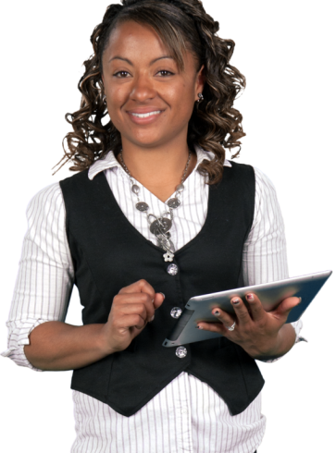
On-the-Job Challenges
Xers and Millennials
Prefer electronic communication.
Do not like meetings.
Many have not developed listening skills.
Traditionalists and Boomers
Prefer face-to-face communication.
Boomer bosses like to have at least one meeting each week with employees.
Notes:
Xers and Millennials prefer electronic communication. Therefore, Xers and Millennials do not like meetings and many have not developed listening skills.
Traditionalists and Boomers prefer face-to-face communication. Boomer bosses like to have at least one meeting each week with employees.
Again, how should you apply this?

Slide 26
Bridging the Generation Gaps
For all employees
Appreciate differences
Acknowledge your interdependency
Appreciate what you have in common
Notes:
Acknowledge that everyone is different. Being different does not make you wrong – it just makes you different. Seek to understand and then be understood and collaborate.

Slide 27
Bridging the Generation Gaps
For all employees
Accept and appreciate another’s perspective
Take responsibility for making your relationships better
Notes:
YOU are the only one that you can change.
How you think someone SHOULD think or act, doesn’t really matter. Understanding the generations better, may help you work through challenges and improve your relationships in the workplace.

Slide 28
Bridging the Generation Gaps
For all employees
Discuss expectations
Inquire about immediate tasks
Look for ways to cut bureaucracy and red tape
Keep up with technology
Notes:
Here are some other ideas on how to bridge the generation gap in the workplace from researchers who have studied what works.
For all employees
Discuss expectations. Find out what others expect and let them know what you expect.
Inquire about immediate tasks. How does doing “A” get you to “B.”
Look for ways to cut bureaucracy and red tape.
Keep up with technology.

Slide 29
Bridging the Generation Gaps
For Managers
Focus on goals
Make everyone feel included
Break the bonds of tradition
Show employees the future
Encourage balance
Notes:
And here is what you can do as a manager trying to get all the generations working together toward common goals.
For Managers
Focus on goals to resolve problems without dampening enthusiasm.
Make everyone feel included. Keep an open mind. Encourage each generation to mentor the other.
Break the bonds of tradition. If there is a better way to do something take the suggestion.
Show employees the future. Tell them where the organization is going, how they fit in, and how to prepare.
Encourage balance. Employees of all ages place a high value on balancing their work and personal lives.

Slide 30

When We are Focused We See with Clarity
Each person has a different perspective
The brain filters reality through experience, beliefs, education and imprints a new reality.
Notes:
Each one of us has a personal choice of whether we value and appreciate the differences we have with those in other generations, or not.

Slide 31
Call to Action!
What You Can Start Doing Right Away
Build good working relationships
Implement best practices
Understand the workforce
Be open to other opinions

Slide 32
Thank You !!!

