Slide 1
Post Partum Depression
Trupti K. Patel, MD
Deputy Chief Medical Officer
ADHS/Division of Behavioral Health

Slide 2
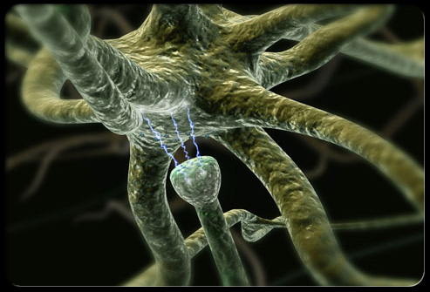
First Record of Depression
Hippocrates in the 4th Century provided the first description of depression
He called it “melancholia”
Believed it was caused by excess black bile in the brain
(Areti & Bemporad, 1978)

Slide 3

When does it occur?
Postpartum Period is typically the first six weeks after delivery.
50% - 80% of women experience transient “baby blues” within the first two weeks following delivery

Slide 4
When does it occur?
0.1% to 0.2% of women experience postpartum psychosis usually within the first 4 weeks following delivery
Postpartum Depression (PPD) can occur anytime during the first twelve months after delivery

Slide 5

Why worry about PPD?
Women are at increased risk of mood disorders during periods of hormonal fluctuation-
  Premenstrual
  Postpartum
  Perimenopausal

Slide 6
Why worry about PPD?
The incidence of depression among women peaks between 18-44 years of age (the child bearing age)
PPD is common
  6.8 – 16.5% of women experience PPD also known as Postpartum Major Depression (PMD)

Slide 7

Impact of PPD
Potential Impacts on:
  Baby:
    Delayed cognitive and psychological development
    Fussier and vocalize less
    Delayed motor skills
    Increased healthcare resource use
  Marriage & Partnerships
    Doubles risk of dissolution

Slide 8

What are the symptoms of PPD?

Slide 9
Symptoms of PPD
Symptoms range:
  from mild dysphoria
  to suicidal ideation
  to psychotic depression
PPD Symptoms don’t last for just a few days
  1/2 of the women are symptomatic for 6 months
  1/3 of women continue to be symptomatic at 12 months especially if untreated

Slide 10
In a Utah study, higher rates of PPD were noted among women who:

Slide 11
Risk Factors for PPD:

Slide 12
What can be done?
Screen all women for PPD during WIC visits!
Why? Because:
  a woman may be unable to recognize she is depressed
  may believe her symptoms are “normal” for a new mom
  Fear being labeled a “bad mother” if she admits her maternal experience does not meet society’s picture of bliss
  may fear her baby will be taken from her if she admits to her “crazy” symptoms

Slide 13
Screening
Several tools available:
Edinburgh Postnatal Depression Scale
PHQ-9
The Mills Depression & Anxiety Checklist
  The Center for Epidemiological Studies Depression Scale (CES-D)

Slide 14
Screening
Ask three simple questions:
  Have you felt overwhelmed in the last 7 days?
  Do you have thoughts of harming yourself or your child?
  Are you having difficulty adjusting to your new role as a mother?
If they answer yes to any of the above questions, then provide referrals to public health nurses or their health care provider who can screen them.

Slide 15
Edinburgh Postnatal Depression Scale
(EPDS):
Specifically for PPD
It is sensitive but not specific:
  that means it identifies almost all women who might be depressed, but also identifies some women who are not depressed (false positives)
  it can be preliminarily scored and forwarded to a physician for further review based on the score

Slide 16
EPDS Scoring
Designed for home or outpatient use
Consists of 10 questions
Can be completed in approximately 5 minutes
Reviews feelings from the previous 7 days
Scored 0-3 depending on symptom severity

Slide 17
EPDS Scoring
Interpreting the scores:
  9 or less low depression concerns
  10 – 12 modest concern
  13 – 18 moderate concern
  19 and above likely to have depression concern and worry about suicide risk

Slide 18
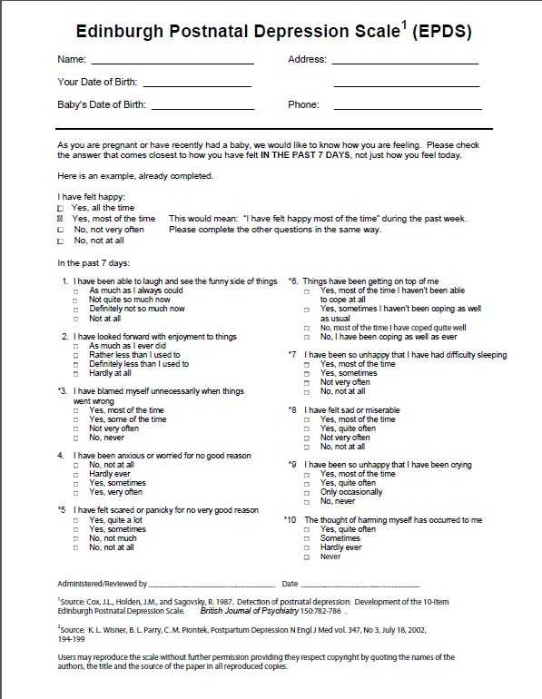

Slide 19
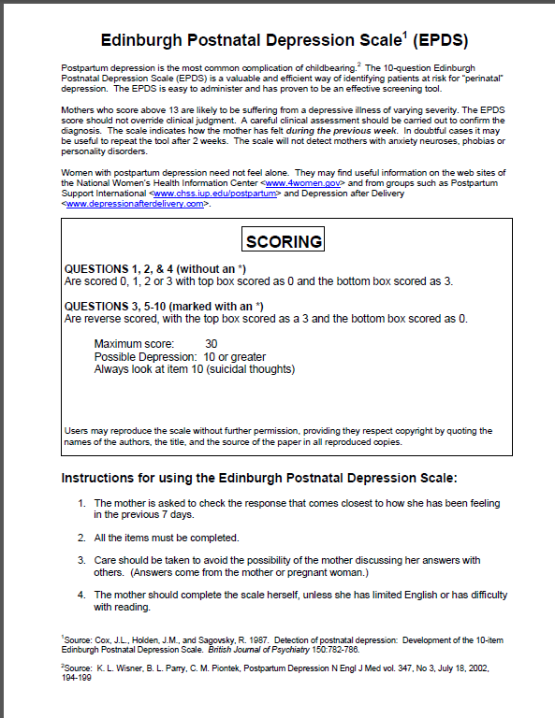
Treatments

Slide 20
Treatment
If found at risk for PPD, refer the patient to their PCP especially if they are family physicians
Or refer the patient back to their OB/Gyn
If patient is to found to be at higher risk, i.e., suicidal, refer to a crisis line or emergent psychiatric evaluation
If patient has other psychiatric history then consider referring them to the Regional Behavioral Health Authority (RBHA) especially if they have not been previously in the T/RHBA system

Slide 21


Treatment
Options include:
  Pharmacological treatments
  Counseling, individual and/or group
  Support groups

Slide 22
Resources
Healthy Families Arizona
  www.azdes.gov/healthy_families_arizona
Postpartum Support International
  www.postpartum.net
Postpartum Education for Parents
  www.sbpep.org

Slide 23

Summary
Postpartum depression:
  is relatively common
  may have long-term consequences for mother, infant & family
  is easily missed
  should be screened for
  can be treated successfully

Slide 24
References
Beck AT, Ward, CH, Mendelson M, Mock J, Erbaugh J. An inventory for measuring depression. Archives of General Psychiatry. (June 1961). 4:6:561-571.
2. Cox JL, Holden, JM, Sagovsky R. Edinburgh Postnata
l Depression Scale (EPDS). British Journal of Psychiatry. (1987). 150:782-786.
Epperson CN. Postpartum major depression: detection & treatment. American Family Physician. (April 15, 1999). 59:8:2247-2254.
Mandl KD, Tronick EZ, Brennan TA, Alpert HR, Homer J. Infant health care use and maternal depression. Archives of Pediatric Adolescent Medicine. (1999). 153:(8):808-813.
Stowe Z. Depression after childbirth: I it the “baby blues” or something
more? Pfizer Inc. January 1998.

Slide 25
References
Stowe ZN, Nemeroff CB. Women at risk for postpartum-onset major depression. American Journal of Obstetrics & Gynecology. (August 1995). 173:2:639-645.
Utah Department of Health. (2001). [Untitled]. Unpublished Maternal Mortality Review
Utah Department of Health. (2001). [Untitled]. Unpublished PRAMS data.
Whiffen VE, Gotlib IH. Infants of postpartum depressed mothers: temperament and cognitive status. Journal of Abnormal Psychology. (1989). 98:3:274-279.
10. AAFP.org: http://www.aafp.org/patient-care/nrn/studies/all/trippd/ppd-
toolkit.html

