Slide 1


Bureau of EMS and Trauma System
Secure, Encrypted, On-Line
EMS System
5/2018
2018 Train the Trainer Series
4
2018
Train the Trainer
Series
4
Submitting A Renewal EMCT Application

Slide 2


Bureau of EMS and Trauma System
Secure, Encrypted, On-Line
EMS System
What is an EMCT?
Think of it like this, the term EMCT is the house and EMCTs are the people in that house with the titles of:
► EMCT - “EMT”
► EMCT- “AEMT”
► EMCT – “Intermediate- I-99 “ (EMT I-99)
► EMCT- “Paramedic”
Collectively, they are considered
Emergency Medical Care Technicians

Slide 3
Bureau of EMS and Trauma System
Secure, Encrypted, On-Line
EMS System
What EMCT Applications Are Accepted By The Bureau?
As of August 12, 2012, Arizona Statute only authorizes the following new certification of Emergency Medical Care Technicians as defined in A.R.S. § 36-2201.
► Emergency Medical Technician “EMT”
► Advanced Emergency Medical Technician “AEMT”
► Emergency Medical Technician I-99 (EMT I-99)
(Current Arizona Certified Only)
► Paramedic

Slide 4
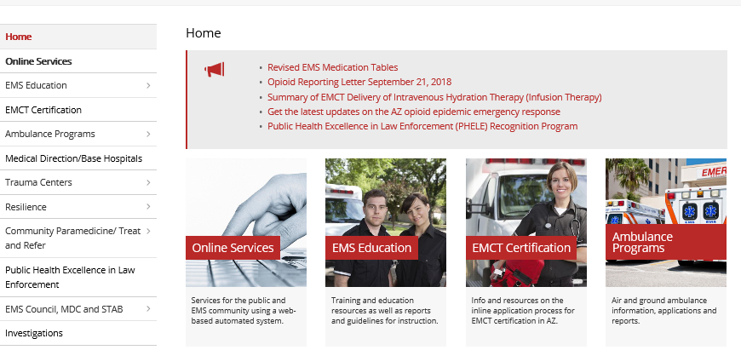

Bureau of EMS and Trauma System
Secure, Encrypted, On-Line
EMS System
How Do I Submit An Application?
Step 1: Simply go to:
https://www.azdhs.gov/preparedness/emergency-medical-services-trauma-system/index.php
On the left side of the
Bureau Web Page Select:
“Online Services”

Slide 5
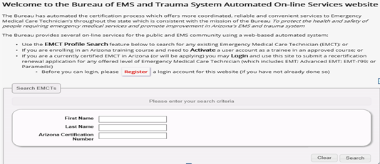
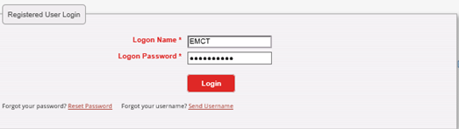
Bureau of EMS and Trauma System
Secure, Encrypted, On-Line
EMS System
Once your Account is Activated
Step 2:
On the On-line Services page,
Click “Login.”
Step 3:
Now you are in the login page. Enter your Login Name and Password, then
Click “Login.”

Slide 6
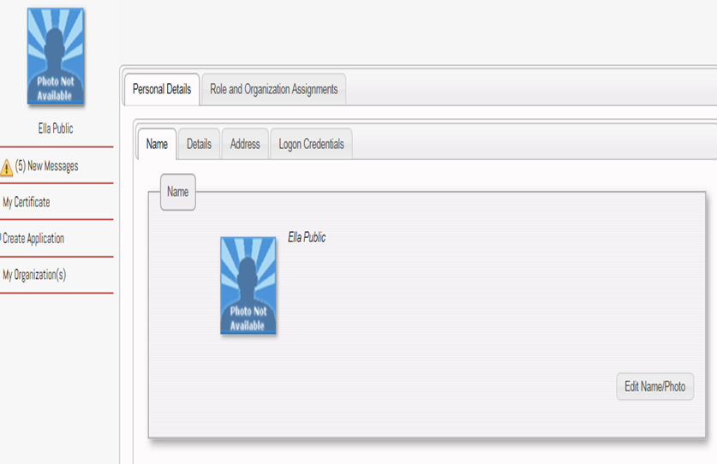
Bureau of EMS and Trauma System
Secure, Encrypted, On-Line
EMS System
Step 4:
Once you are in your EMCT account, select:
“Create Application”

Slide 7
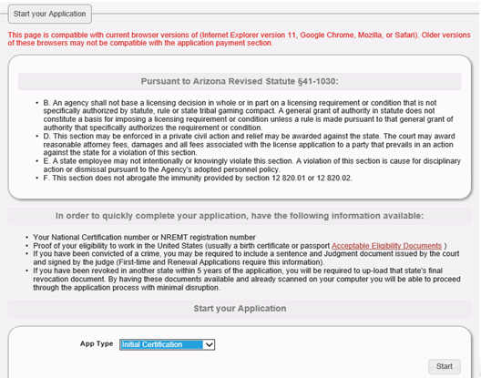
Bureau of EMS and Trauma System
Secure, Encrypted, On-Line
EMS System
Once you have clicked on “Create Application,” you will get this advisory screen telling you what documents will be needed as you proceed through the on-line application process.

Slide 8

Bureau of EMS and Trauma System
Secure, Encrypted, On-Line
EMS System
If the applicant does not have the capability to scan a document, there are office supply stores that will scan and email a document to the applicants email address for a fee; or the applicant can use his/her mobile phone by taking a photo of the document and emailing it to him/herself. The applicant can then upload the document into the application. If the applicant is required to upload more than one document, for example a birth certificate and a copy of a marriage certificate to show legal proof of name change, the applicant will need to have a scanner that will scan multiple documents for both documents to be uploaded as one file. If the applicant uploads one document at a time, the second document will replace the first document uploaded showing only one document has been uploaded.

Slide 9
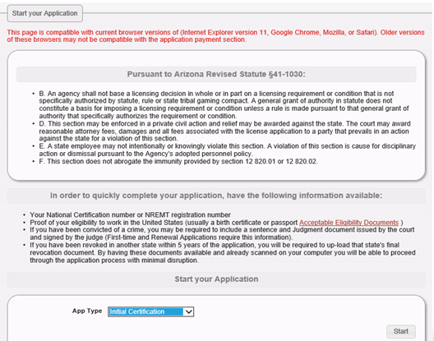

Bureau of EMS and Trauma System
Secure, Encrypted, On-Line
EMS System
First, using the drop down menu, select the type of application you wish to submit. Your options may be:
Renewal of Certification
Downgrade of Certification Level
Applicant Name Change
Extension to File for Renewal
* Some Application Types will not be available to you depending on the status of your Certificate.
When ready, click on the “Start” button.

Slide 10
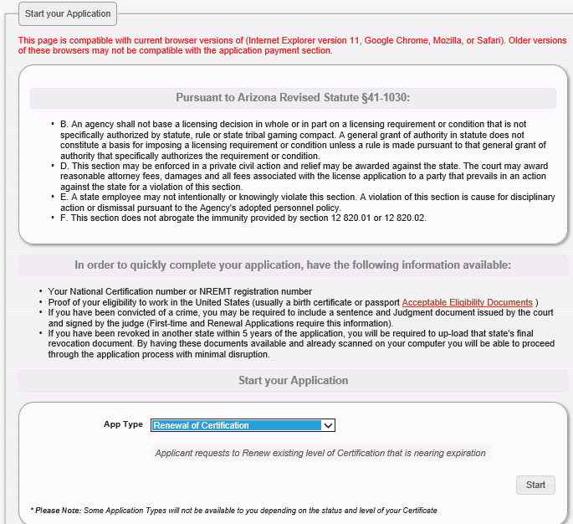
Bureau of EMS and Trauma System
Secure, Encrypted, On-Line
EMS System
Select the Application Type you wish to submit by using the dropdown menu. An initial applicant will only have the option to create an initial application. Once you select the type of application, click on the “Start” button. The system will have you confirm your personal information. If no changes are necessary, click on the “Next” button until you get to the first page of the application.

Slide 11
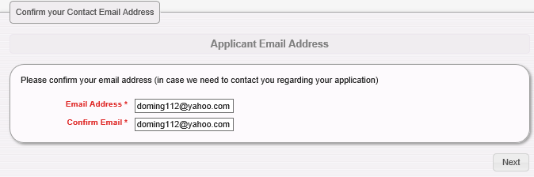

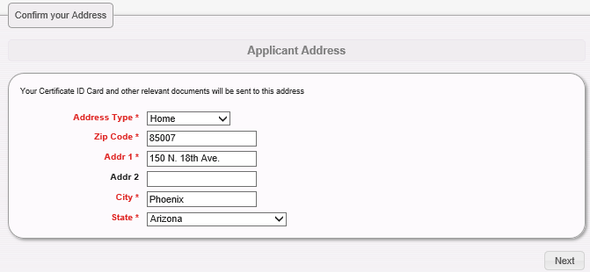
Bureau of EMS and Trauma System
Secure, Encrypted, On-Line
EMS System
Once you start the application, the system will have you confirm your email address and your home address. You can make corrections if needed. It is important to keep your personal information updated at all times. If we need to contact you regarding your certification, the information you provide is what we will be using.

Slide 12
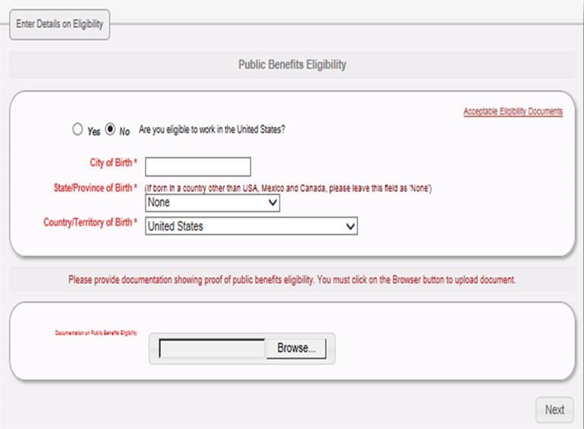
Bureau of EMS and Trauma System
Secure, Encrypted, On-Line
EMS System
This screen will only appear to applicants if they have not yet provided proof of right to work in the United States to the Bureau.

Slide 13
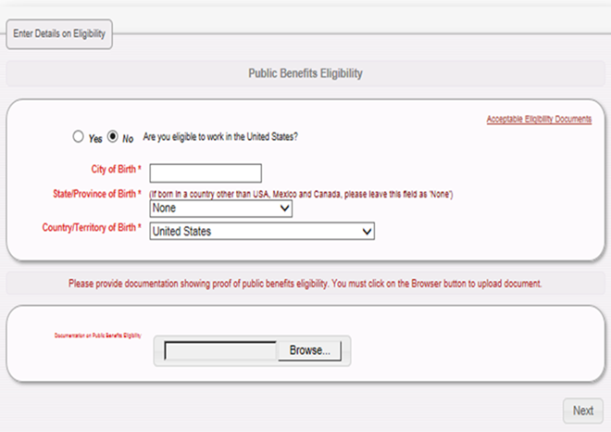

Bureau of EMS and Trauma System
Secure, Encrypted, On-Line
EMS System
If the Public Benefit Eligibility screen appears and you are not certain what document qualifies as proof of eligibility, click on “Acceptable Eligibility Documents” located on the top right of the screen. This will provide a list of eligible documents.
Acceptable Eligibility Documents

Slide 14
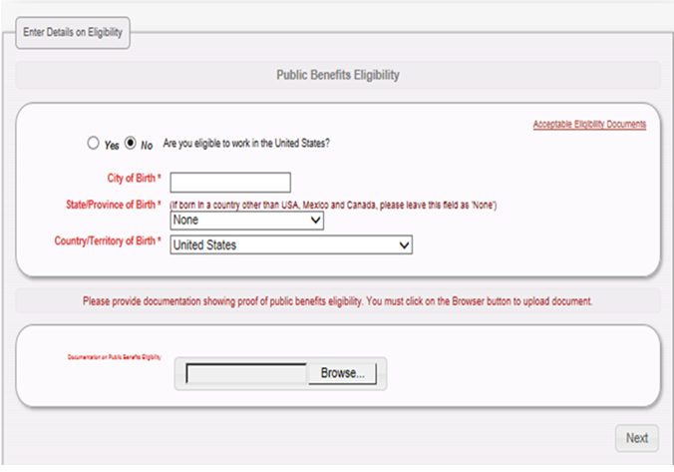

Bureau of EMS and Trauma System
Secure, Encrypted, On-Line
EMS System
Now that you have your eligibility document in an electronic format, click on the “Browse” button and the system will open your personal computer’s file where you can select the document to upload.
Again, this screen will only appear if you have not already provided this to the Bureau.
Acceptable Eligibility Documents

Slide 15
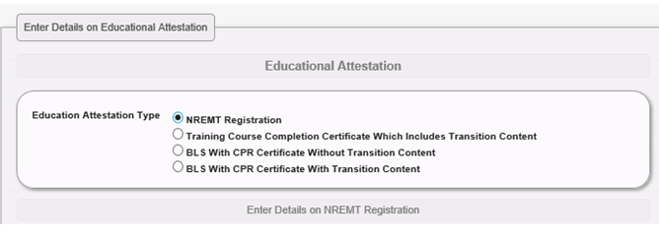
Bureau of EMS and Trauma System
Secure, Encrypted, On-Line
EMS System
This section provides the applicant the ability to enter a current National Certification Organization “NCO”/National Registry “NREMT” registration number; If renewing with NREMT. If a refresher was completed, then select the 2nd choice to upload a course completion certificate, etc.
This is not a required field, if the applicant has current Arizona certification.

Slide 16
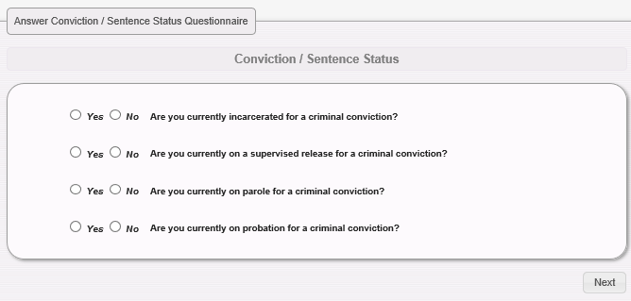

Bureau of EMS and Trauma System
Secure, Encrypted, On-Line
EMS System
This section of the application contains the conviction/sentence questions.
Be cautious, and make sure the responses are accurate!

Slide 17
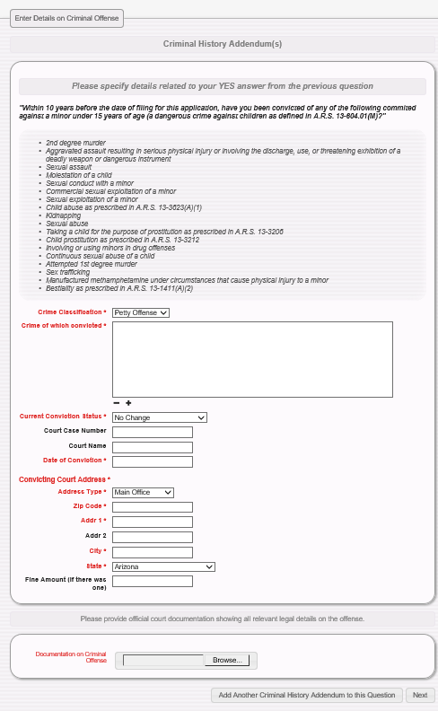

Bureau of EMS and Trauma System
Secure, Encrypted, On-Line
EMS System
This section is a follow-up of the conviction/sentence questions
requiring additional information related to the criminal conviction responses which reflect an affirmative answer.
Using the Drop Down, select the conviction classification:
Petty Offense
Misdemeanor
Felony

Slide 18
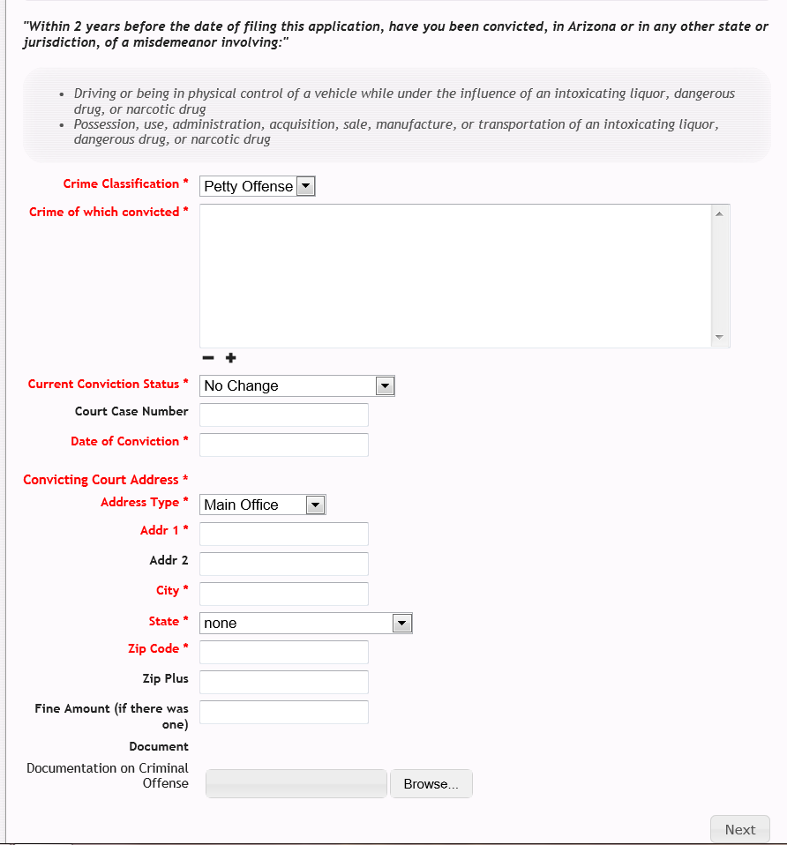
Bureau of EMS and Trauma System
Secure, Encrypted, On-Line
EMS System
Now, the applicant must identify the criminal violation, such as Theft, DUI, Extreme DUI, Illegal Consumption, Domestic Violence, Possession of Marijuana, Burglary, etc.

Slide 19
Bureau of EMS and Trauma System
Secure, Encrypted, On-Line
EMS System
The system defaults to no change in the conviction. However, if a conviction has been expunged, vacated, set aside, or reduced to a misdemeanor, the applicant will use this drop down to reflect any change to the original conviction

Slide 20
Bureau of EMS and Trauma System
Secure, Encrypted, On-Line
EMS System
In this field, the applicant will enter the “court case number” which appears on the court document.
For Example:
CR-2009-9868758844

Slide 21
Bureau of EMS and Trauma System
Secure, Encrypted, On-Line
EMS System
In this field, the applicant will enter the date of the conviction, NOT the date of arrest.
This can be found near the end of the court document where the Judge signed the judgment.

Slide 22
Bureau of EMS and Trauma System
Secure, Encrypted, On-Line
EMS System
This section is a follow-up Criminal History Addendum requiring additional information related to the criminal conviction responses which reflect an affirmative answer.
Be prepared to upload an electronic copy of your court documents on this page.

Slide 23
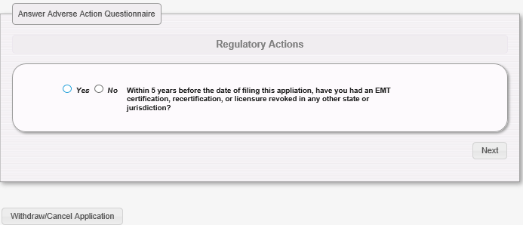

Bureau of EMS and Trauma System
Secure, Encrypted, On-Line
EMS System
This section of the application is the Regulatory History question.
Be cautious, and make sure the responses are accurate!

Slide 24
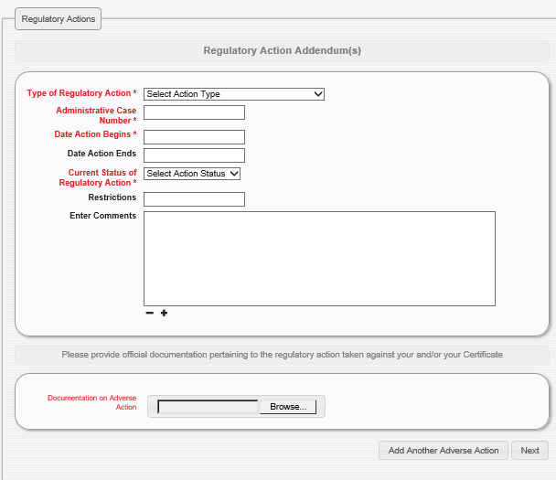

Bureau of EMS and Trauma System
Secure, Encrypted, On-Line
EMS System
This section is a follow-up regulatory history addendum requiring additional information related to the adverse actions taken by a regulatory agency.
Be prepared to upload an electronic copy of any regulatory action document on this page.

Slide 25
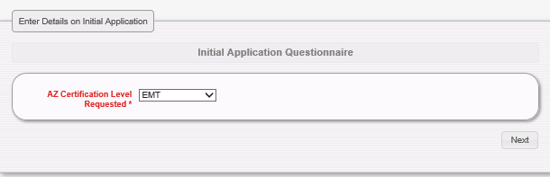
Bureau of EMS and Trauma System
Secure, Encrypted, On-Line
EMS System
This section of the application is where the applicant selects the level of certification.
Using the drop down menu, select one of the following:
EMT
Advanced EMT
Intermediate EMT-99
Paramedic

Slide 26
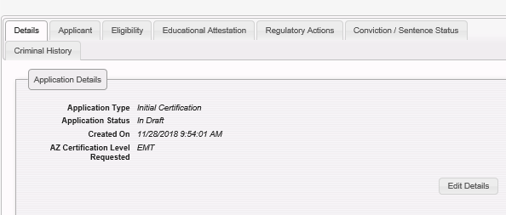
Bureau of EMS and Trauma System
Secure, Encrypted, On-Line
EMS System
Applicant is in the home stretch now and is being provided an opportunity to review the information provided prior to submitting the application to the Bureau for review.
By clicking on each of the tabs, the applicant may review the information and make any changes necessary.

Slide 27
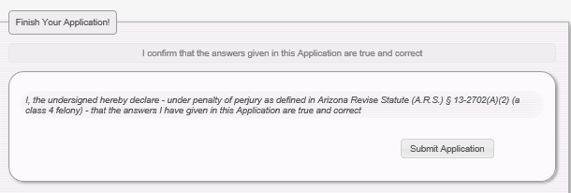
Bureau of EMS and Trauma System
Secure, Encrypted, On-Line
EMS System
Once the applicant is satisfied with the application content, the applicant would click:
“Submit Application”
NOTE: It is the responsibility of each individual to recertify every two years before the expiration of current certification.

Slide 28
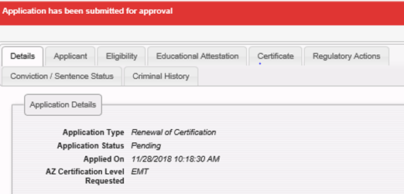

Bureau of EMS and Trauma System
Secure, Encrypted, On-Line
EMS System
Once the application is submitted, the applicant will notice a red label above the tabs stating:
“Application has been submitted for approval.”
The application status will change from “Draft” to “Pending.”

Slide 29
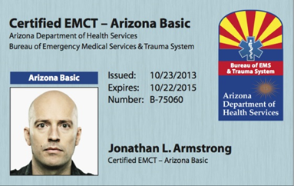
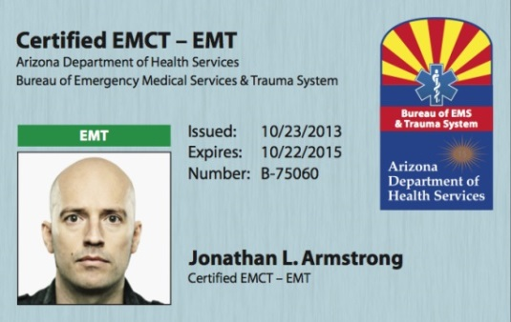
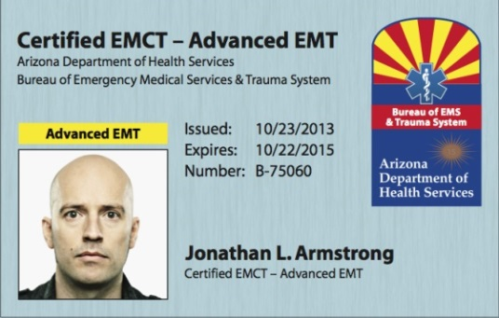
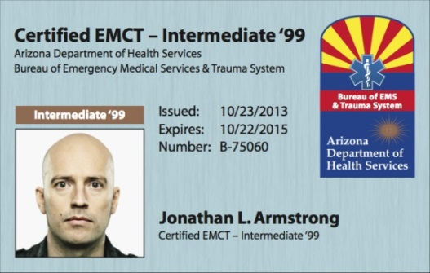
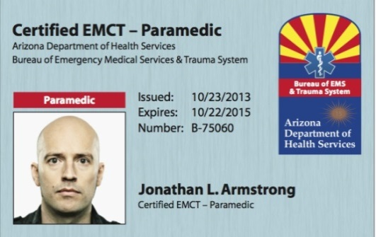
Bureau of EMS and Trauma System
Secure, Encrypted, On-Line
EMS System
Your new certification card will be mailed to you the next business day after your application has been approved.

Slide 30

Bureau of EMS and Trauma System
Secure, Encrypted, On-Line
EMS System
Please feel free to contact the Bureau’s certification main number for assistance during normal State of Arizona business hours (M-F, 8-5):
Certification Main Number
602-364-3150
Maria Dominguez, Manager
Kathleen Rodriguez, Customer Service Representative
*During normal business hours, excluding state holidays and weekends.

Slide 31
Bureau of EMS and Trauma System
Secure, Encrypted, On-Line
EMS System

